Slide 1
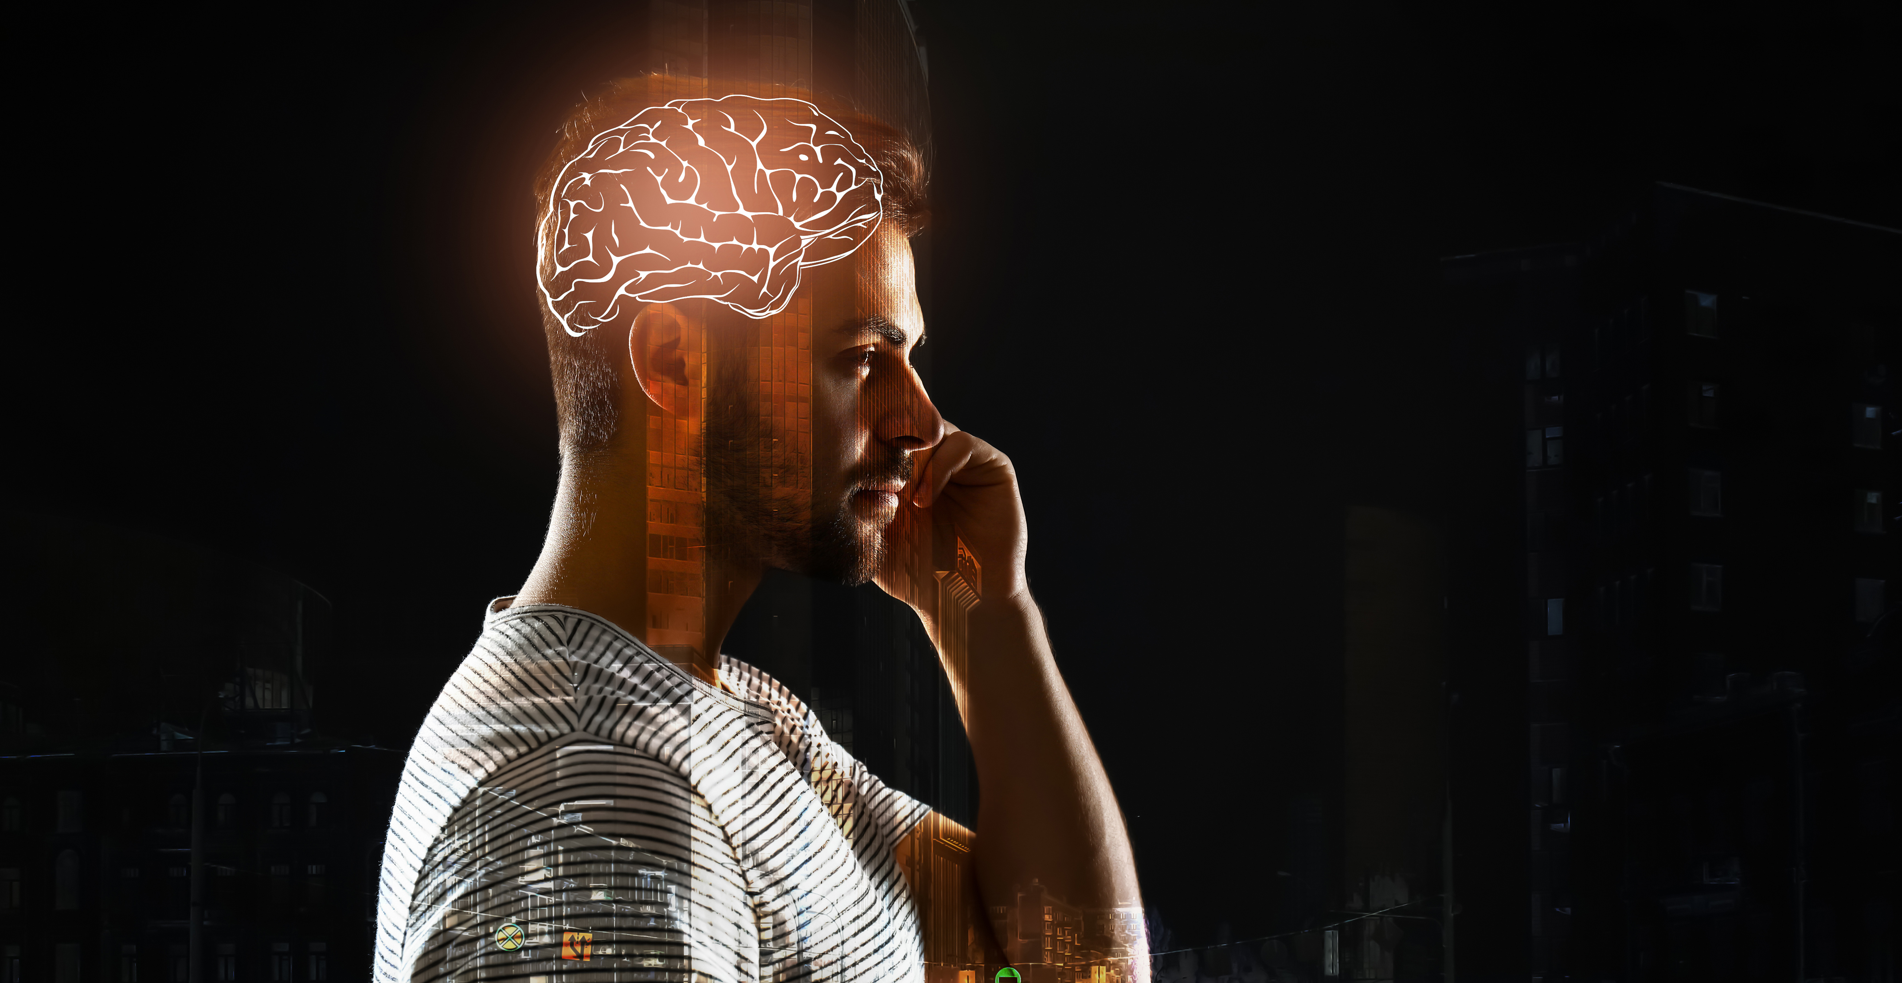

Uncovering Bias
Presented by:
Joelle Martinez, President/CEO of Latino Leadership Institute

Slide 2

Understanding DEI
©2019 Latino Leadership Institute

Slide 3
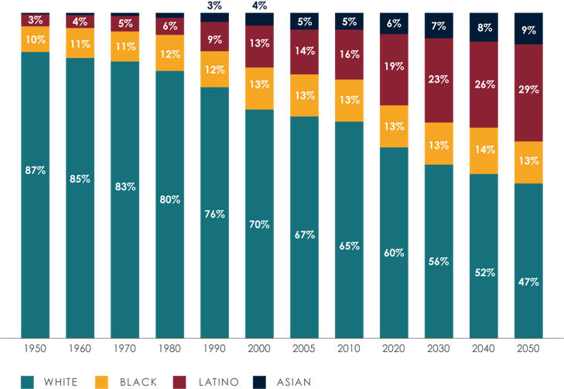
Demographic Shifts
Keys takeaways from the 2020 Census:
Diversification is taking place throughout the U.S.
Check the box is no longer acceptable for the younger generation
Population growth has slowed but diversity has not
Source: U.S. Census population projections released March 13, 2018 and revised on September 6, 2018.
© 2021 Latino Leadership Institute

Slide 4
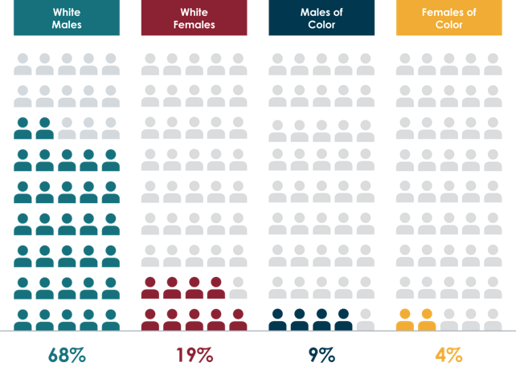
Inclusion Index
Question:
What do you believe is the biggest challenge to diversifying executive leadership today?
Source: Women in the Workplace 2018, in which LeanIn.org and McKinsey examined the employee pipeline of 279 US corporations.
© 2021 Latino Leadership Institute

Slide 5
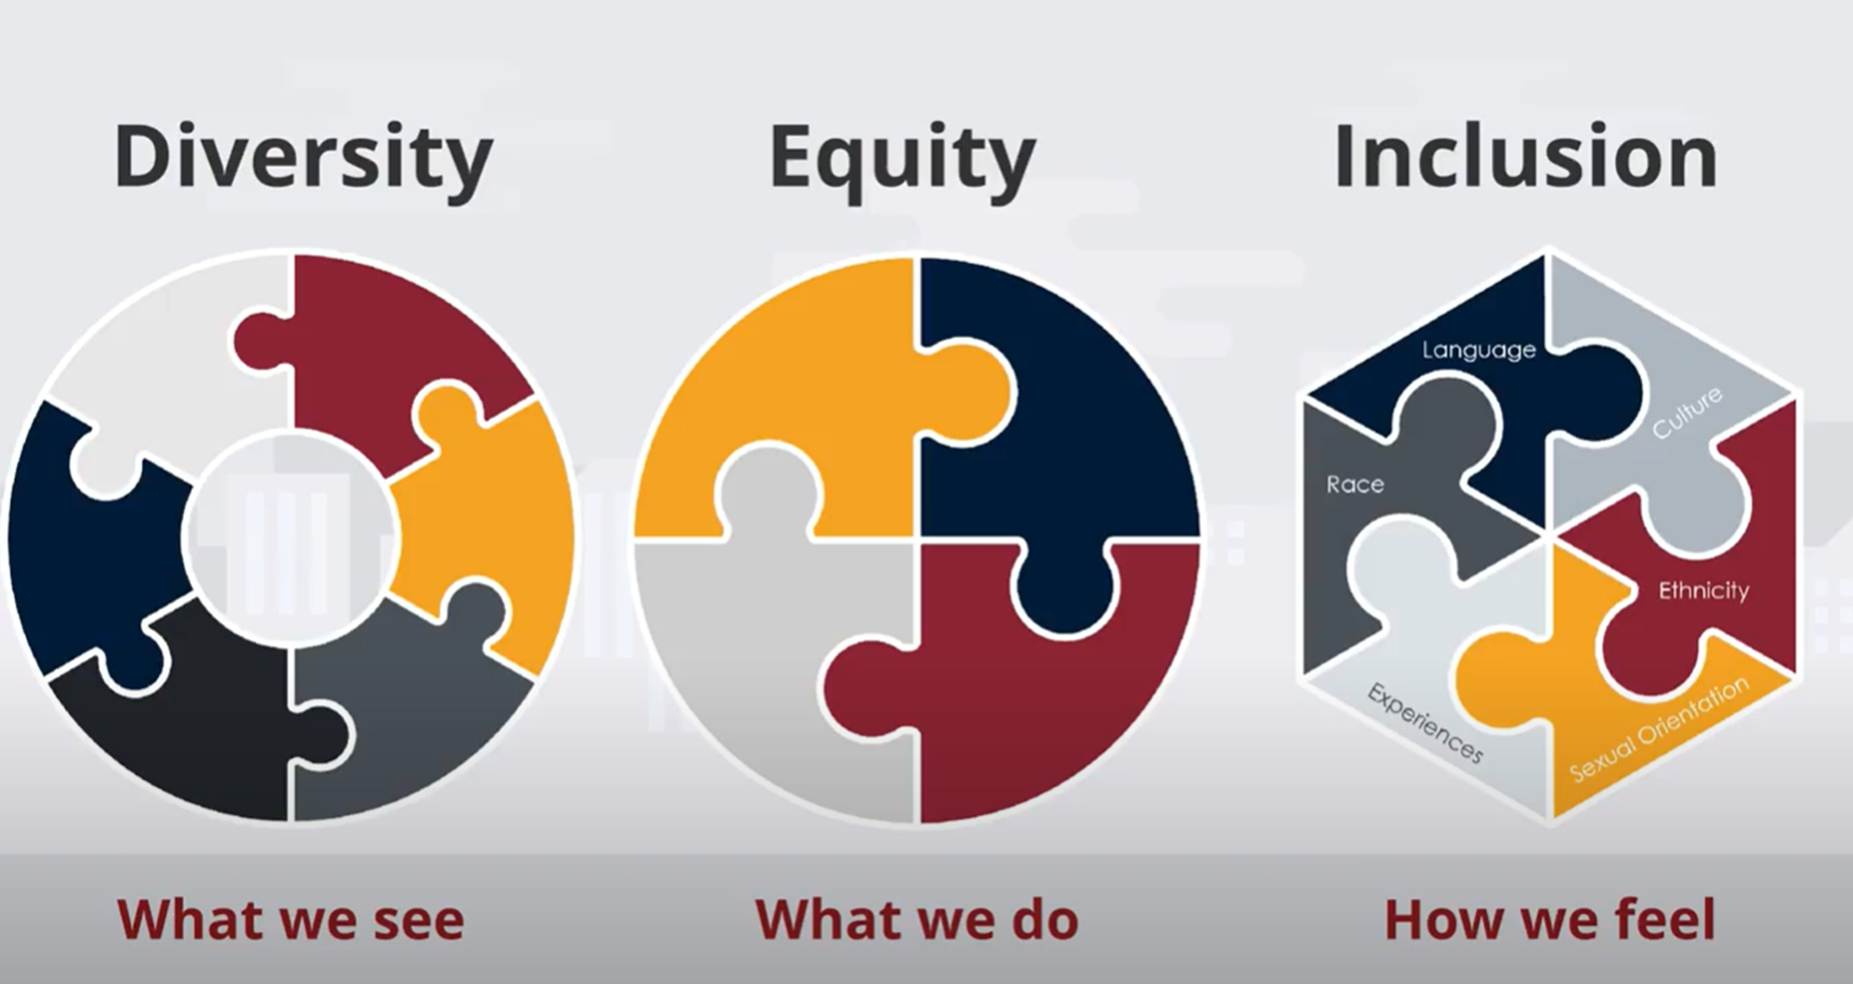
Defining DEI
Diversity is having a seat at the table.
Equity is fair access to the table.
Inclusion is the feeling that you have a voice at the table.
Belonging is the outcome of being heard.

Slide 6
Self-Reflection:
Think of a time in your career when you did not feel like you belonged.
How did that impact your confidence or work?
©2019 Latino Leadership Institute

Slide 7
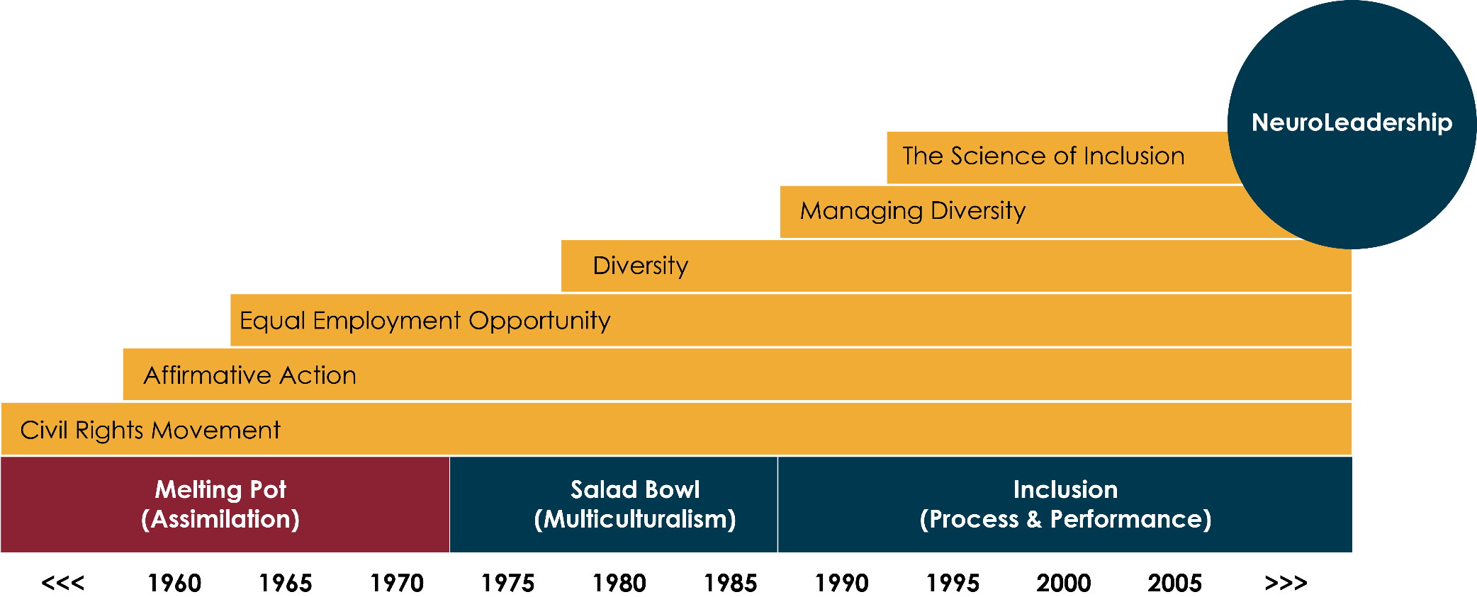
History of DEI

Slide 8
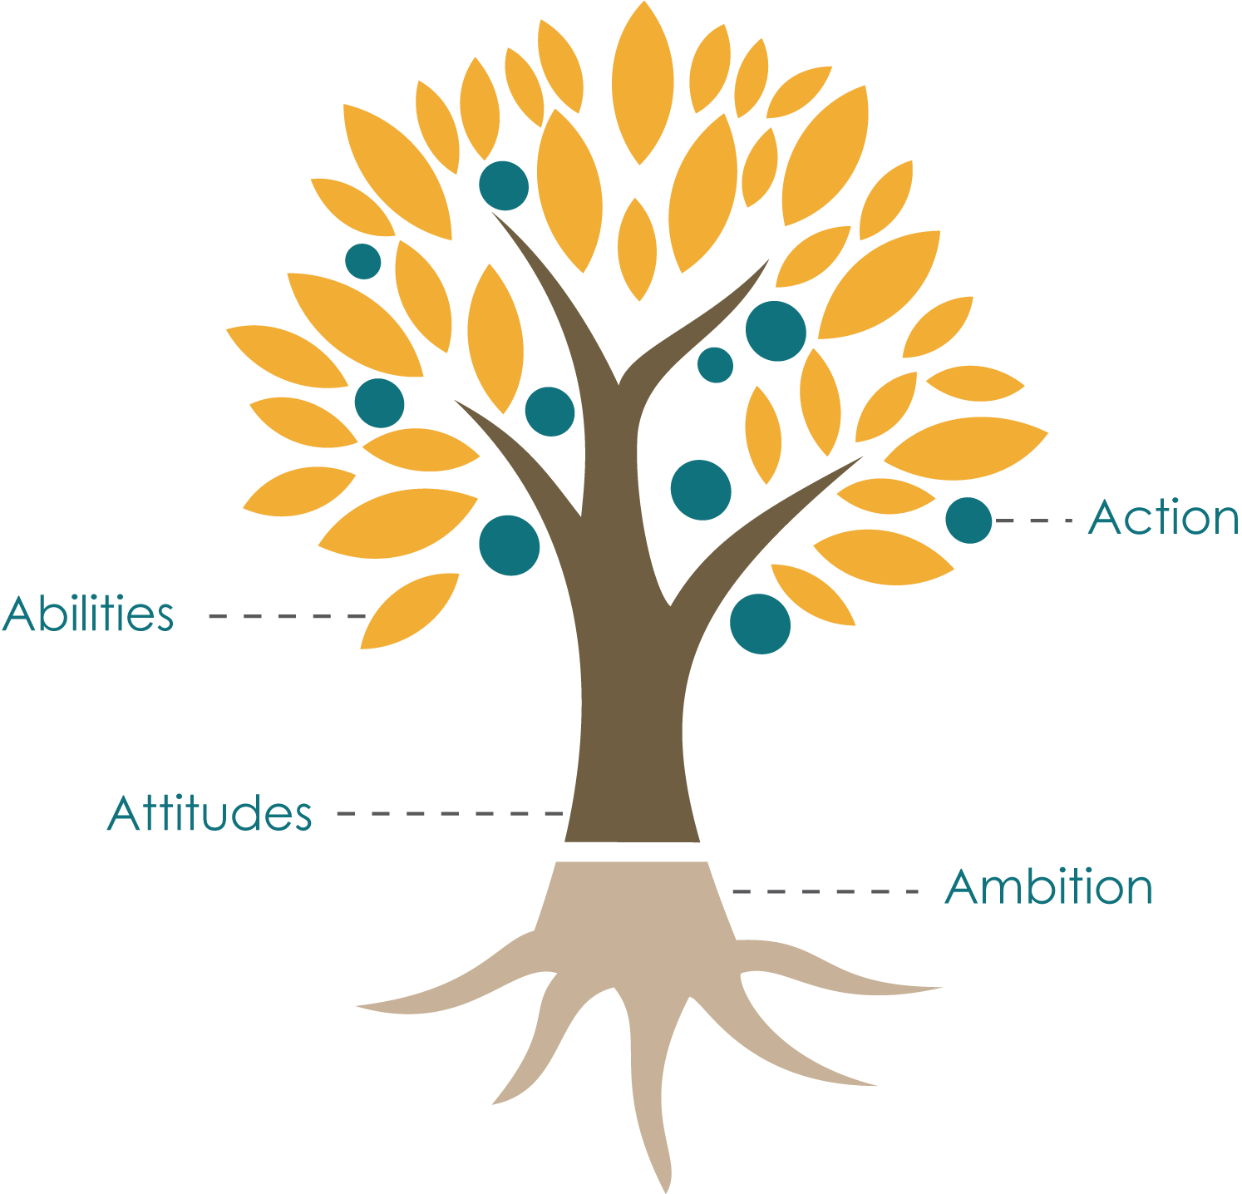
Science-based and Results-driven
Neuroscience of inclusion incorporates the science of defensive thinking and results-driven strategies for inclusive practices.

Slide 9
Understanding Bias
©2019 Latino Leadership Institute

Slide 10

Six Insights about the Brain
The brain is a connection machine.
No two brains are alike.
The brain hardwires everything it can.
Hardwiring drives automatic perception.
It is practically impossible to deconstruct mental wiring.
It is easy to create new wiring in the brain.

Slide 11
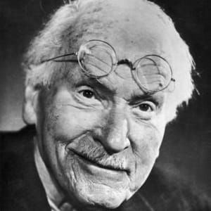
“Until you make the unconscious conscious,
it will direct your life and you will call it fate.”
- Carl Jung
©2019 Latino Leadership Institute

Slide 12
Question:
At what age did you start to form stereotypes about people?
©2019 Latino Leadership Institute

Slide 13
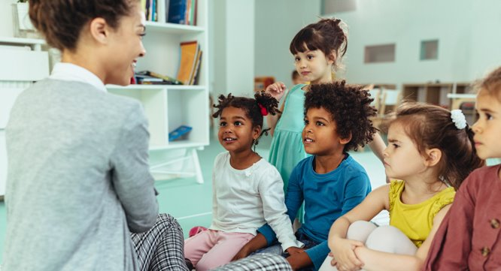
Roots of Bias
Children start to apply stereotypes at a very young age
Between the ages of 3 and 5, children begin to categorize people by race and express bias based on race
Source: Winkler, E.N. (2009) Children Are Not Colorblind: How Young Children Learn Race. High Reach Learning
© 2021 Latino Leadership Institute

Slide 14

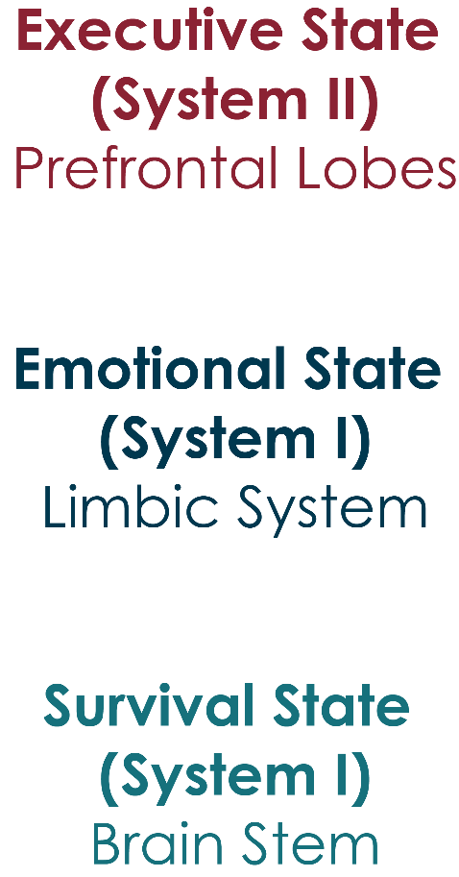
Triune Brain Theory
PRIMATE
MAMMALIAN
REPTILIAN
#

Slide 15
Question:
What percentage of your decisions are based on emotion?
©2019 Latino Leadership Institute

Slide 16
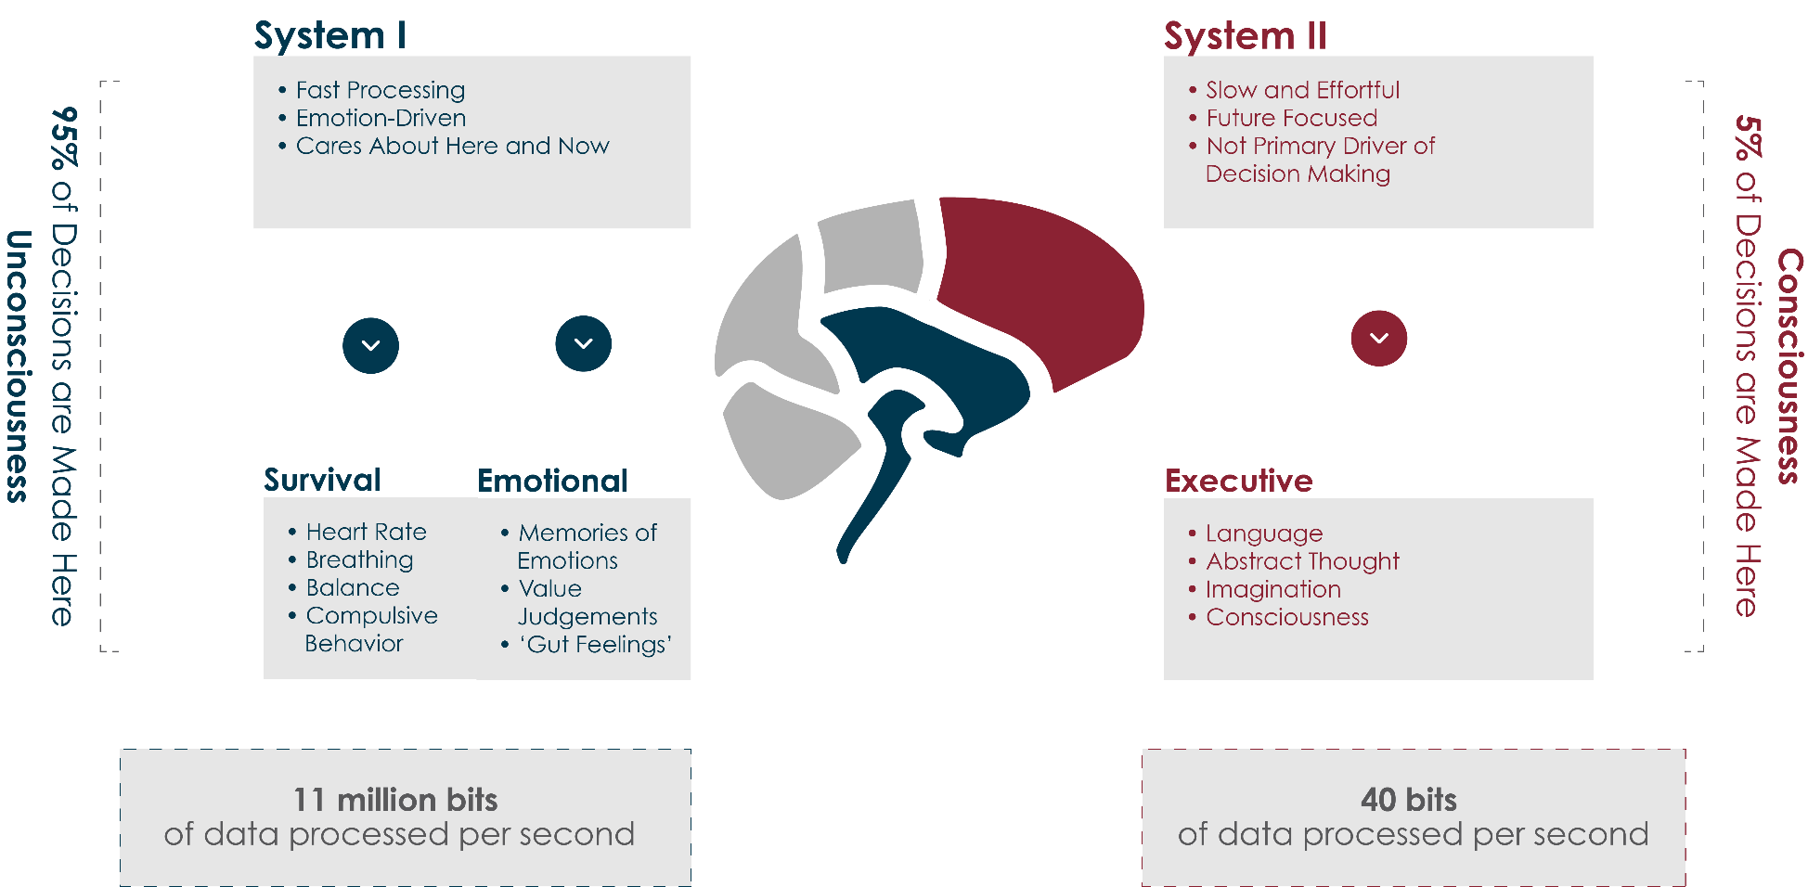
Decisions and the Brain

Slide 17
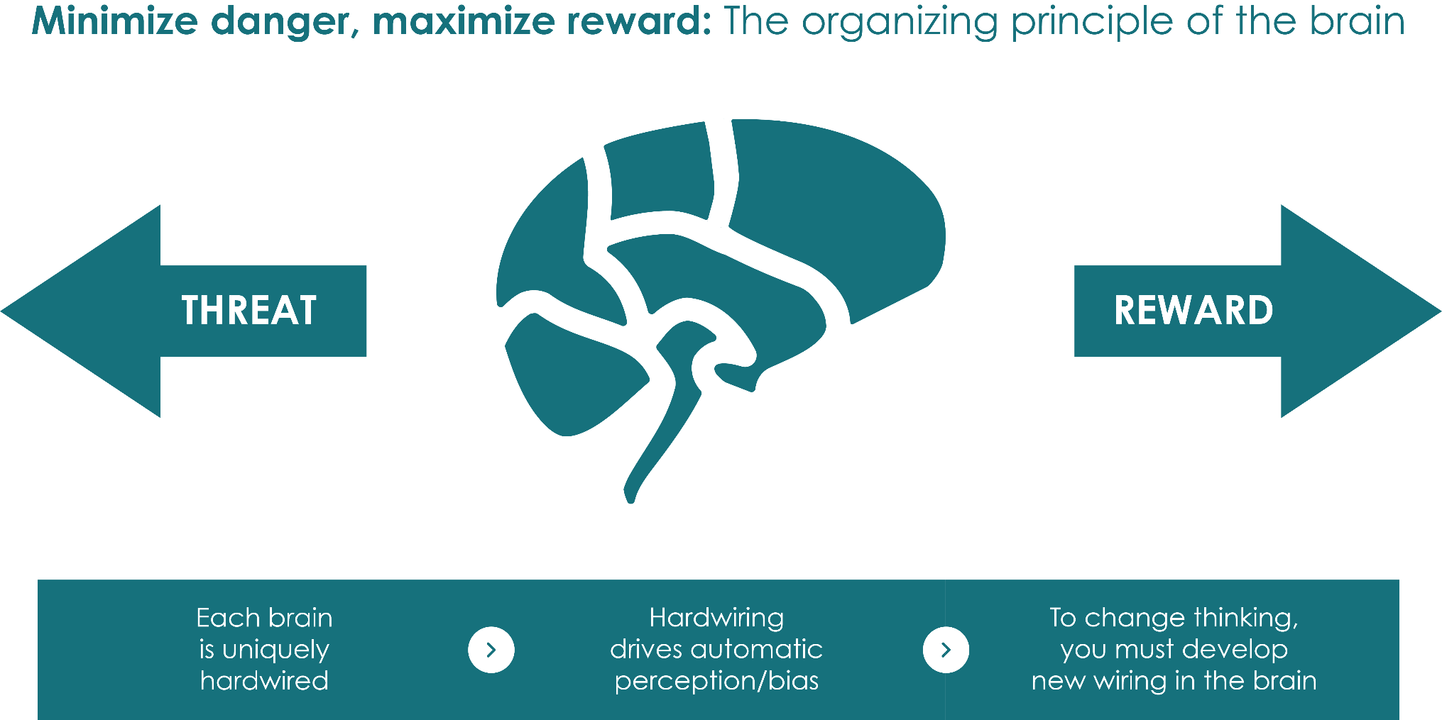
Alarm System

Slide 18
Common Biases
©2019 Latino Leadership Institute

Slide 19
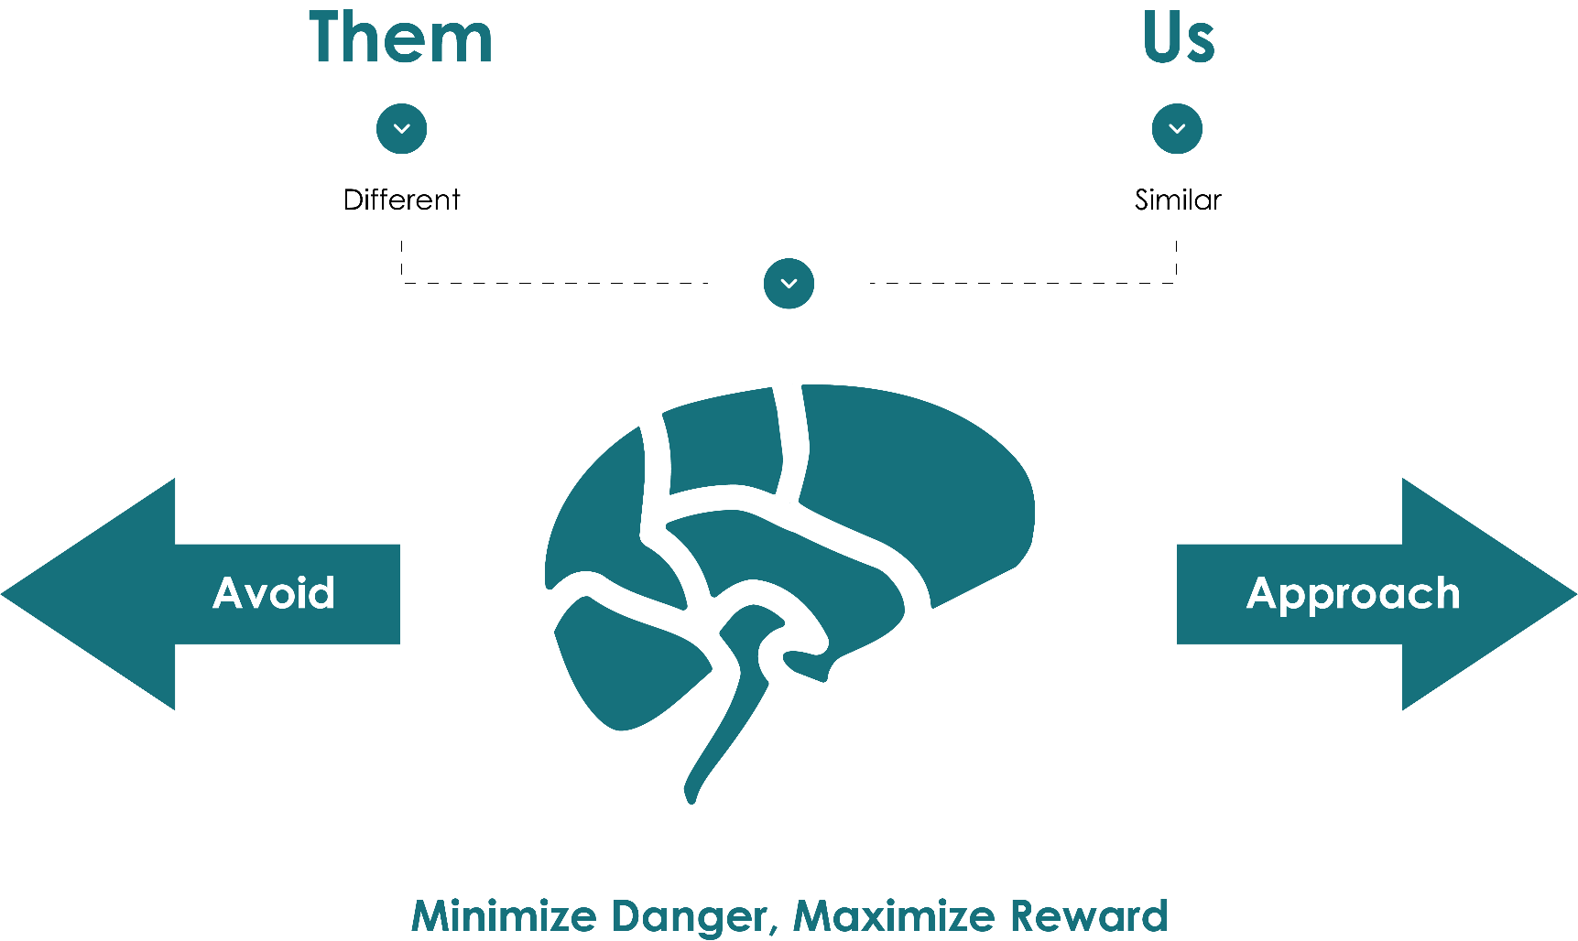
Affinity Bias

Slide 20
Self-Reflection:
Think of a time when you met someone for the first time and found out that they were from your hometown or attended your alma mater.
How did those connections impact your first impression of them?
©2019 Latino Leadership Institute

Slide 21
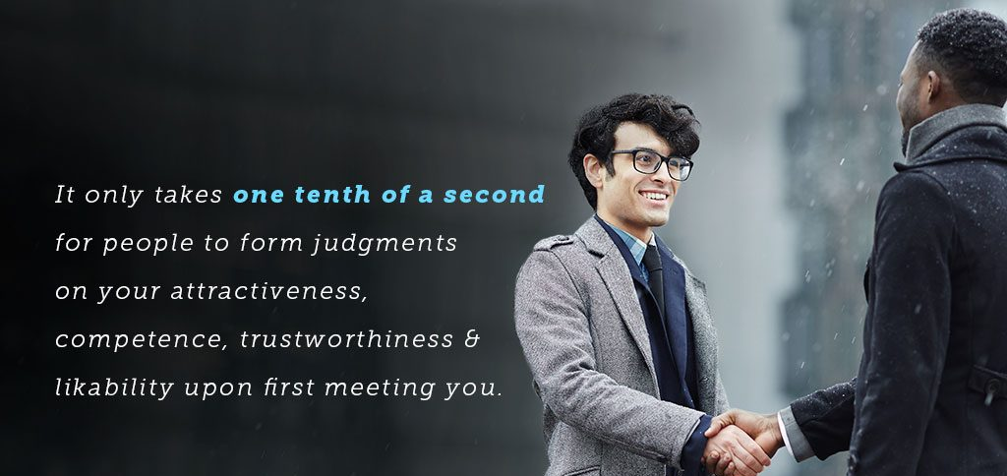
Primacy Effect
Primacy Effect. First impressions disproportionately influence how we interpret
and remember information. People resist changing opinions once they’re formed.

Slide 22
Insight to Inclusive Leadership
©2019 Latino Leadership Institute

Slide 23

S.E.A.T. Model
To become a more inclusive leader and SEAT more diverse talent around the table, you need to be:
S
Self-aware
E
Empathetic
A
Active
T
Trusting
© 2021 Latino Leadership Institute

Slide 24
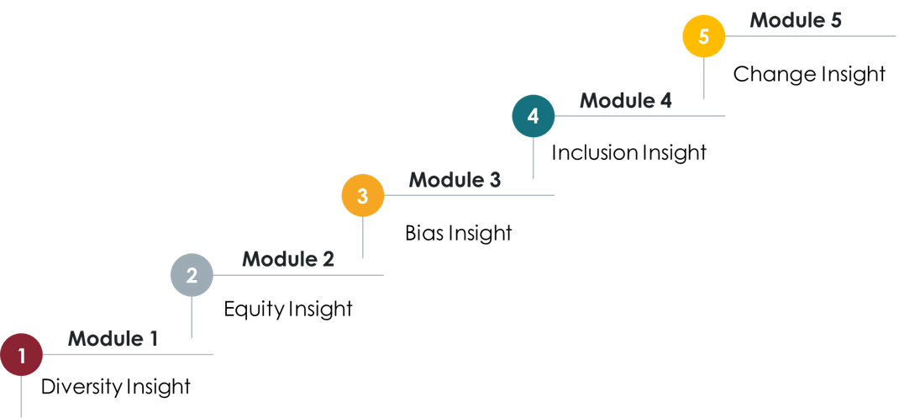
Our Program
© 2021 Latino Leadership Institute

Slide 25
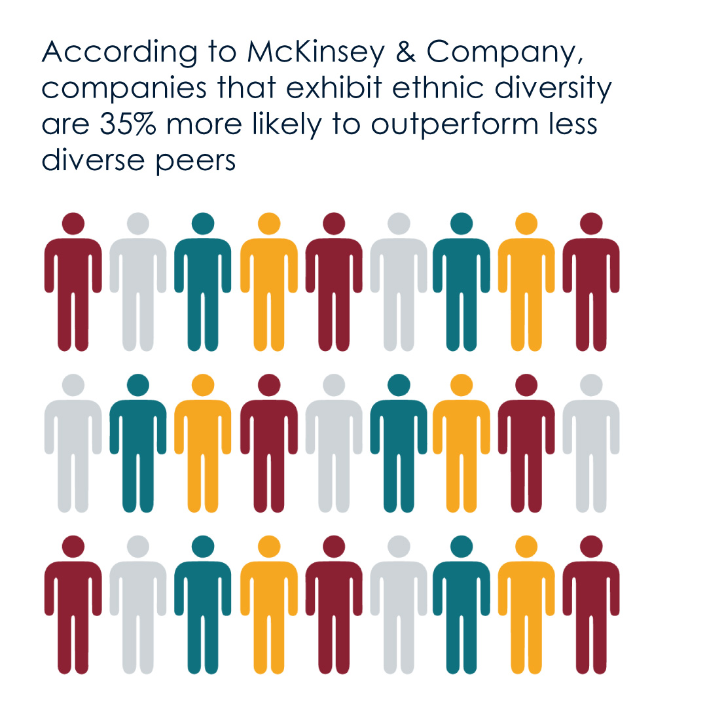
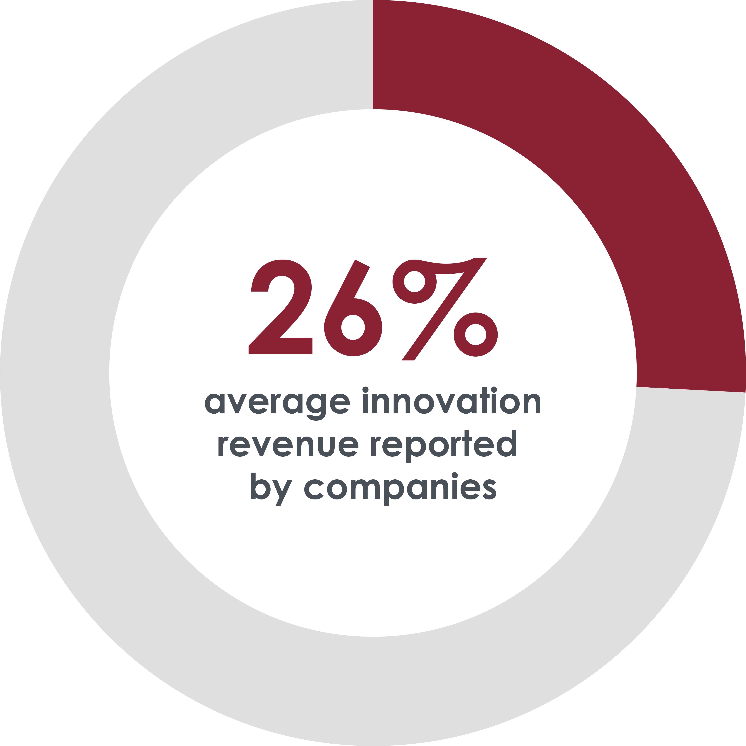
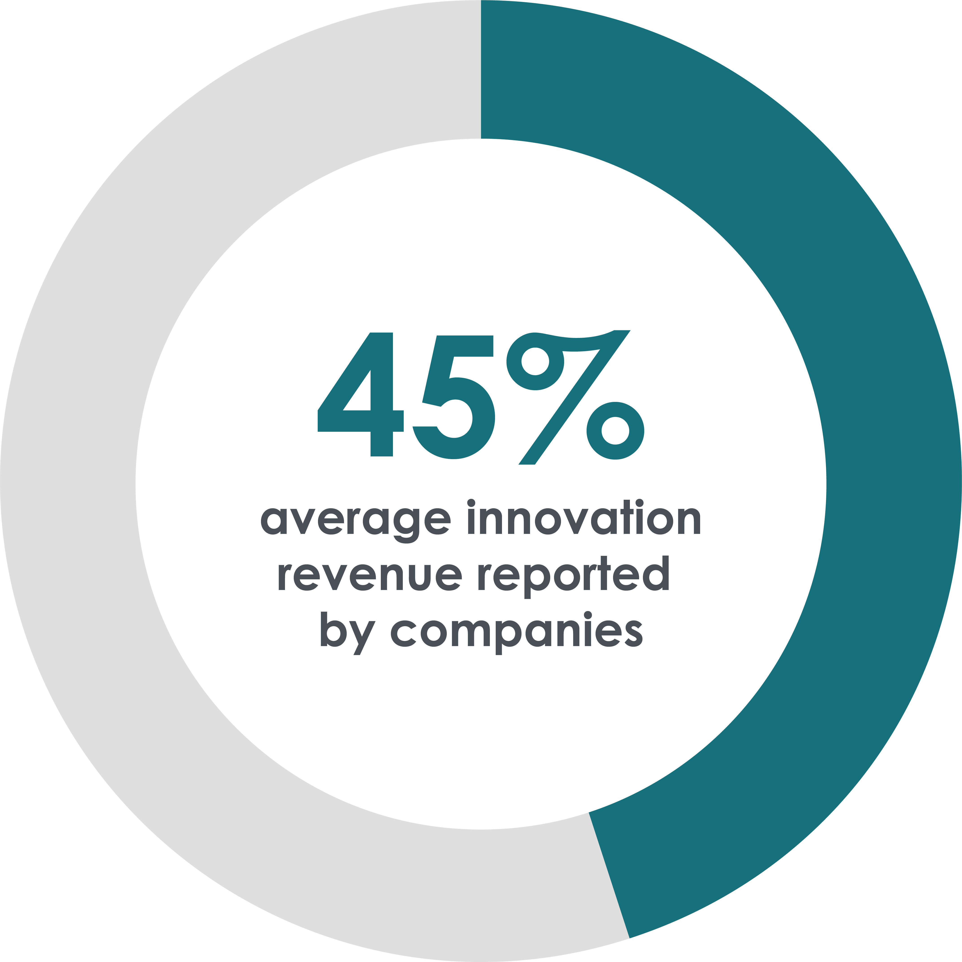
The ROI
Companies with below-average diversity scores
Companies with above-average diversity scores
© 2021 Latino Leadership Institute

Slide 26
Q&A
©2019 Latino Leadership Institute

